Slide 1
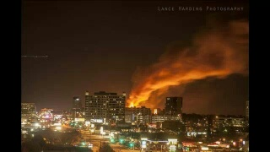
Incident Command SOG

Slide 2
Incident Command SOG
ICS SOG focused on the most common ICS terminology and levels used on the DFD
ICS flexibility-many ways to structure an incident correctly within the ICS framework
Due to the variability of each incident, unwise to prescript organizational structure (exception on the DFD is Tech Incidents)
Build ICS to fit the incident, not make the incident fit ICS

Slide 3
Incident Command SOG
The vast majority of incidents on the DFD do not progress beyond the Single Resource level
Next most frequently used level is Groups/Divisions
Higher levels above Groups/Divisions rarely used on DFD but everyone should be familiar with them. This PowerPoint focuses on Single resources/Groups/Divisions
Refer to SOG for info on Branch level and above

Slide 4
Incident Command SOG
Span of Control- number of individuals that a supervisor is responsible for, expressed as the ratio of supervisors to individuals
Ideal Span of Control varies between 1:3 to 1:7
Complex incidents may require a Span of Control on the lower end of the range
Experienced IC may be comfortable with a Span of Control on the higher end of the range

Slide 5
Incident Command SOG
Factors that affect span of control
Experience level of supervisor/ IC
Experience level of subordinates
Complexity of incident
Size
Type
Rapid growth vs stabilizing quickly

Slide 6
Incident Command SOG
As long as a supervisor is within the suggested Span of Control of Single Resources, higher ICS levels do not necessarily need to be implemented
Only use/add what you need in your command structure

Slide 7
Incident Command SOG
Single Resources
An individual, piece of equipment with personnel, or a crew or team with a supervisor (Examples: Chief 2, Rescue 1, Engine 22)
Lowest level of ICS

Slide 8
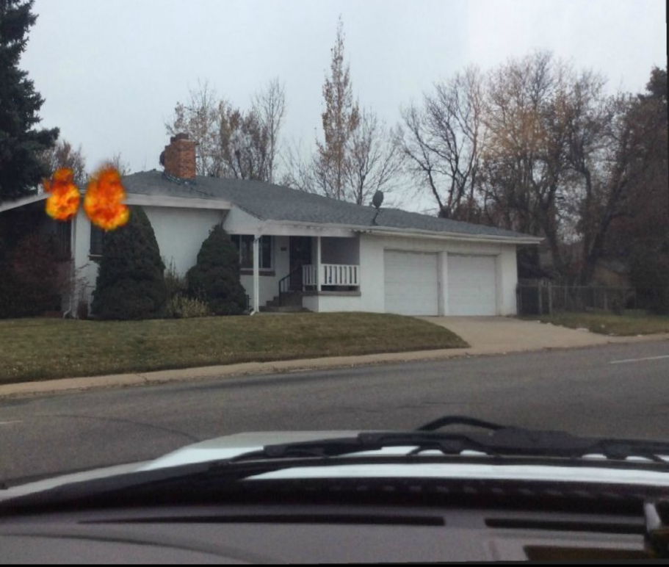
Incident Command SOG
Example of a fire that can be handled with only Single Resources

Slide 9
Incident Command SOG
In the previous slide, this fire would need 1 Engine with an Attack Line, 1 Engine with a Back Up Line, 1 Truck to Search, 1 Truck to the roof, 1 RIT, and all other Companies standing by for a Span of Control for the IC of 1:5. No Groups/Divisions needed.

Slide 10
Incident Command SOG
Groups/Divisions
Next level used by DFD in ICS above Single Resources
Groups-responsible for completing a task
Example- Search Group for conducting a search of a structure
Example- Fire Attack Group for extinguishing a fire
Divisions- responsible for an area
Example- Division 5 for completing all tasks ( search, rescue, extinguishment) on the 5th floor of a structure
Person in charge of Groups/Divisions is a Supervisor
Groups/Divisions are the same management level, one is not subordinate to the other
Horizontally challenged incidents-lean towards using Groups
Vertically challenged incidents-lean towards using Divisions

Slide 11
Incident Command SOG
When creating groups/divisions let everyone know
Name of the Group/Division
Who is in the Division/Group
Responsibilities of the Group/Division
Designation of the Supervisor

Slide 12
Incident Command SOG
Example 1: Truck 12 officer, I am creating a Search Group, you will be my Search Group Supervisor, your crew (T12), T04, and Rescue will be in your Group, your Group will be searching this structure.
Example 2: Chief 4, I am creating Division 2, you will be my Division 2 Supervisor. E15,E08,TR15, and T08 will be in your Division. You will be completing all tasks on the 2nd floor (extinguishment, search, rescue, etc.)

Slide 13
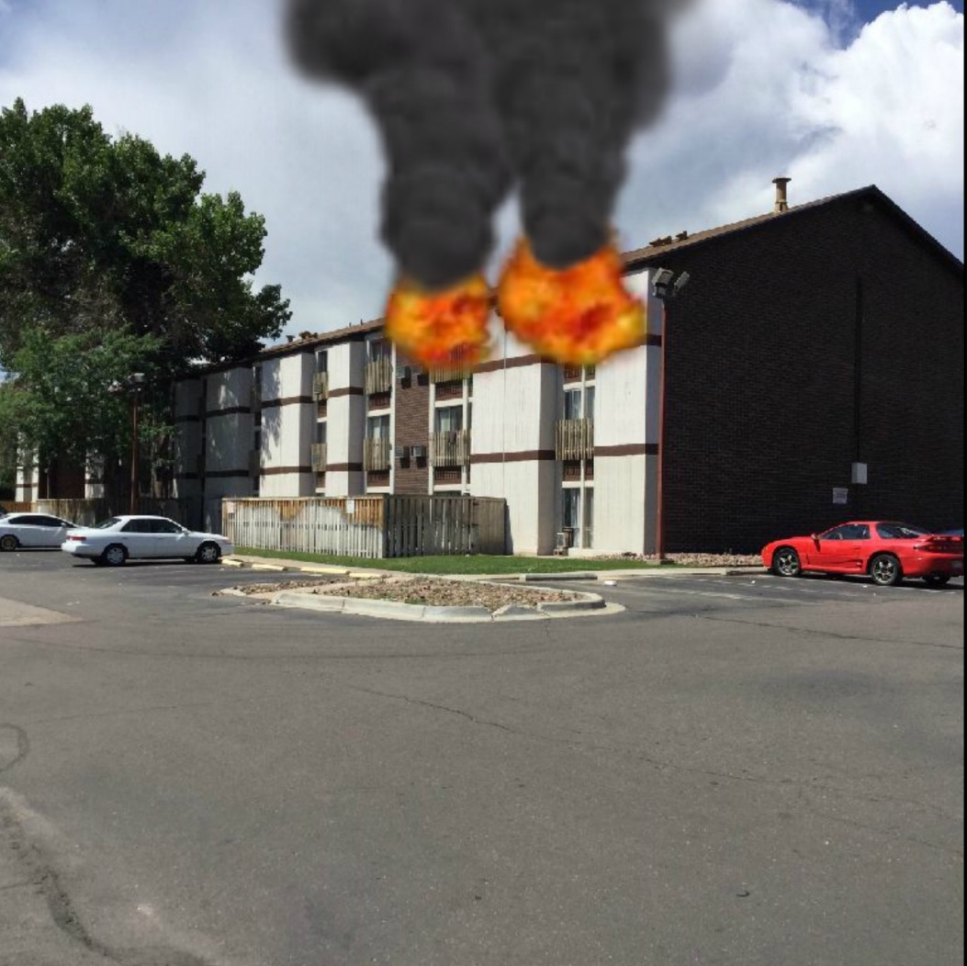
Incident Command SOG
Apartment Fire Example (Divisions)

Slide 14
Incident Command SOG
In the previous slide, this fire would beyond the IC’s Span of Control using only Single Resources. This fire is a good candidate for Divisions. Division 3 for all tasks on the 3rd floor, Roof Division for vertical ventiliation, Division 2 to evacuate the 2nd floor and also to check for extension from the fire above. A Single Resource (one Company) to evacuate the 1st floor if needed.

Slide 15
Incident Command SOG
Apartment Fire Example (cont’d)
Each Division could have up to 7 Single Resources(Companies) in it if needed. Total of 21 Companies with a Span of Control for each Division Supervisor of 1:7 and a Span of Control of 1:3 for the IC.
In this example, if each Division was maxed out, plus having one Company on the 1st floor and a RIT, the IC’s Span of Control would be 1:5 and the Incident would be at a 4 Alarm Level.

Slide 16
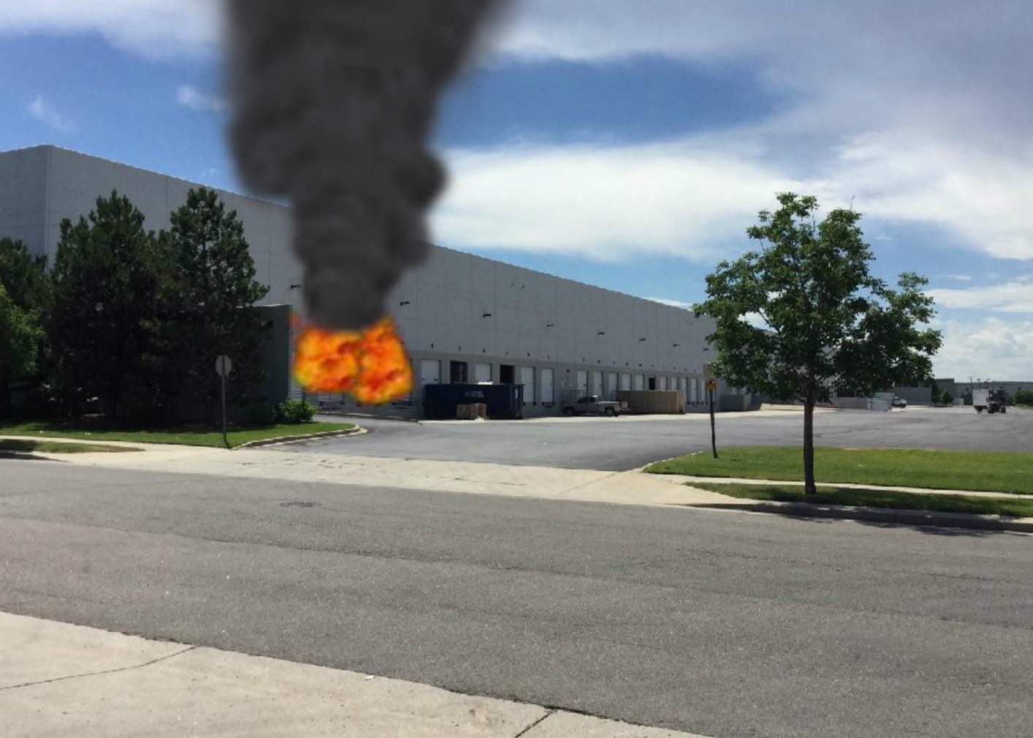
Incident Command
Warehouse Fire Example(Groups/Divisions)

Slide 17
Incident Command
In the previous slide, this fire would beyond the IC’s Span of Control using only Single Resources. This fire is a good candidate for a mix of Divisions and Groups.
A Fire Attack Group with the task of extinguishing the fire.
A Search Group with the task of searching the entire warehouse.
A Horizontal Vent Group to open all bay doors
A Roof Division to evaluate the roof, vent if needed (open skylights or create openings)
By using Groups/Divisions at this fire, the IC could potentially use up to 28 Companies and still be within a comfortable Span of Control

Slide 18
Incident Command
If any of the previous examples progressed into a Defensive fire, the IC could evacuate the structure, do a PAR of each Group/Division, disband those Group/Divisions, and then easily create exterior Divisions based on the sides of the building (Alpha Division, Bravo Division, Charlie Division, Delta Division).

Slide 19
Incident Command SOG
During an incident, as the staffing needs of Groups/Divisions change, the IC can remove/add/reassign Companies as needed, changes will be based upon updates and information obtained from Group/Division Supervisors

Slide 20
Incident Command SOG
The majority of incidents that Denver Fire responds to can be handled by using a very simple command structure (Incident Commander and Single Resources). Larger incidents (example -multiple alarm fires) necessitate the use of Divisions/Groups. All personnel should have a working knowledge of these simpler management levels.

Slide 21
Incident Command SOG
Commonly used Command Staff
Safety Officer: Every group response and technical rescue in Denver has a Safety Officer (Ops-2) assigned automatically.
PIO: At any incident, the Incident Commander can assign a PIO (Public Information Officer) to assist with interactions with the media and public.
Command Staff are not considered as part of the IC’s Span of Control due to their ability to work autonomously.

Slide 22
Incident Command SOG
Branches and Above
There is a huge potential for extremely large and complex incidents to occur in Denver, these incidents could require complex Incident Command structures.
The focus of this PowerPoint is only basic levels of ICS, please refer to the DFD Incident Command SOG for information regarding management levels above that of Groups/Divisions.

Slide 23
Incident Command SOG
Summary
Denver Fire now has an Incident Command SOG to utilize in order for all personnel to understand ICS terminology and management levels that are most commonly used.

Slide 24
